Slide 1
Creating Graphs
That Tell Your Story
Megan Heyman, PhD (heyman@rose-hulman.edu)
Associate Professor, Statistician
Rose-Hulman Institute of Technology
IN MAA Fall Meeting, October 3, 2026

Slide 2


Roadmap
Guidelines for graphics (~15 min.)
  Three “laws” of effective visualization
  Accessibility
2. Published nonexamples (~15 min.)
3. Real data exploration examples using R ggplot2 (~15-20 min.)
Slides, example code, and data:
https://meganheyman.github.io/

Slide 3
Guidelines for Creating Graphs
Understanding best practices may help you identify when something is “sus.”
*Caveats
Notes:
Caveats: Combined information mainly from the Significance “How to present data the Significance Way” series (which was compiled to the RSS data viz guide and the Graphical Principles group. Also utilizes the data to viz.com recommendations. These resources compiled classical resources including Tufte and Wilkinson’s the Grammar of Graphics.
These guidelines may not cover every scenario and there may be other reasonable recommendations that could achieve an appropriate graphic. Creating good (or bad) graphs is an art.

Slide 4
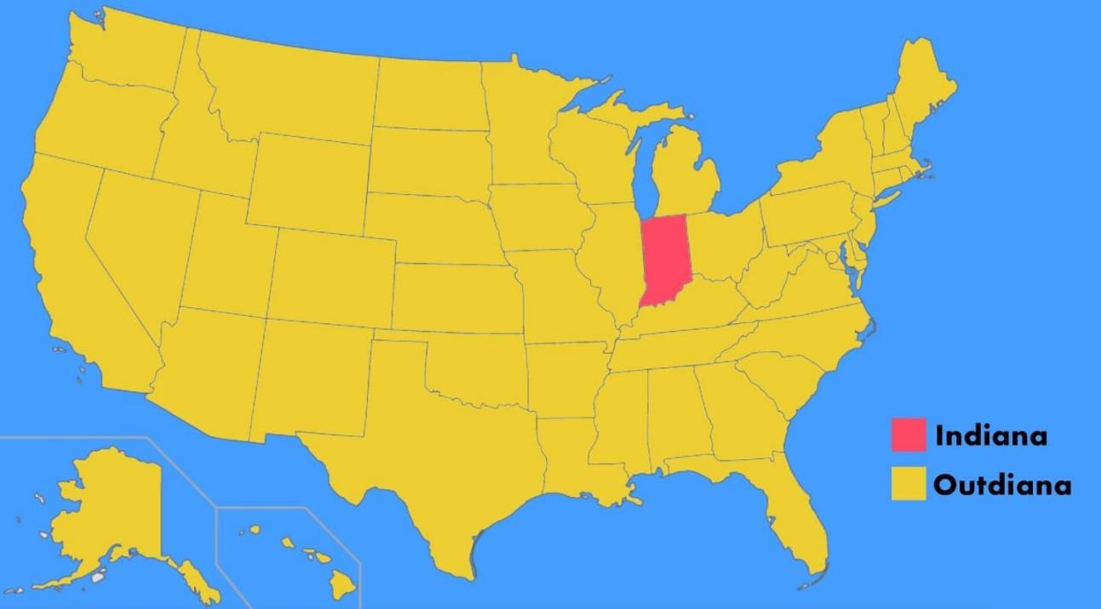
It’s just a really terrible map

Slide 5
Do not edit
How to change the design
Why do we create graphs?
The Slido app must be installed on every computer you’re presenting from

Slide 6
Why visualize data? (Or, why create graphs?)
Grab attention
Attract the reader.
Improve access to information
Efficiently disseminate key points.
Increase precision
Describing data or models via text is too lengthy or not detailed enough.
Bolster credibility
Allow the reader to make the (same?) conclusions.
Summarize content
Help the reader understand the key points of a complex analysis.
Notes:
“Presenting Data the Significance Way: Part 1” Significance, July 2024, p.36

Slide 7
A lot of information, quickly
The next several slides are text heavy. I plan to go through the content quickly.
Want everyone to have the information/references since there are likely varying levels of expertise in the audience regarding communicating with graphics.
The perspectives also focus on display of data, though many easily translate to general graphic displays.
Notes:
Superheroes from the Graphics Principles group: https://graphicsprinciples.github.io/; Villain created by me using ChatGPT.

Slide 8
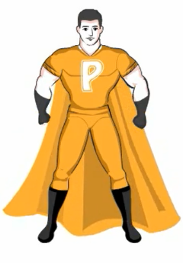


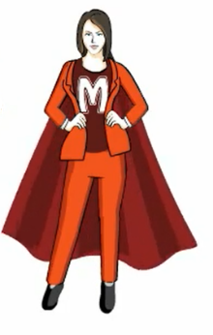
3 laws of effective visual communication
1. Have a clear purpose.
Oppose bad graphs.
2. Show the data clearly.
3. Make the message obvious.
Notes:
Superheroes from the Graphics Principles group: https://graphicsprinciples.github.io/; Villain created by me using ChatGPT.

Slide 9
Have a clear purpose
Who is the intended audience? Consider:
  Technical literacy
  Academic discipline / knowledge domain
  Perhaps the graph is just for you?
Why is the display useful?
  Exploratory: Provide informal insight to relationships within the data and understanding of variable behavior.
  Analysis: Help select the form of the model or type of statistical inference method.
  Results: Communicate results, help support a decision.
What information or variables compose the display?
(When is the display created?)
Notes:
“Presenting Data the Significance Way: Part 3” Significance, November 2024, p. 26; https://graphicsprinciples.github.io/

Slide 10
Show the data clearly
Layout of multiple graph panels is intuitive.
  Graphs with common axes are aligned in a single row or column.
  Axis limits are the same across graphs. In ggplot2 R package, the facet_wrap() function does this automatically.
  Matrix layouts with multiple graphs are OK for unrelated charts
  or cases when there are too many charts for a single row/column.
  Aspect ratio is appropriate.
    Visual perception should not depend on how the graph is “stretched.”
    Consider 1:1 (square) plot spaces, especially when the axes have the same units.
Notes:
“Presenting Data the Significance Way, Part 2” Significance, September 2024, p. 32-33; https://graphicsprinciples.github.io/

Slide 11
Show the data clearly (continued)
Axis limits and format are selected with care.
  Negative values should not be present if the variable is non-negative.
  Strongly consider starting axis ranges at 0. If not, then there should be a good reason for the choice.
  If relative change or ratio is plotted, should consider a logarithmic axis; also consider adding a reference line indicating the point of no change.
Notes:
“Presenting Data the Significance Way, Part 2” Significance, September 2024, p. 32-33; https://graphicsprinciples.github.io/

Slide 12

Make the message obvious
  Lines, points, and color have a purpose beyond decoration.
    Use of lines to connect data points indicates that the x- variable is ordered.
    Line style (weight, dash) can be used to denote groups,
    both ordinal and categorical.
    Color can be used to denote groups, both ordinal and categorical.
    Point symbols can be jittered with discrete data, and open circles or small filled symbols should be considered for use with large datasets.
Legends are useful, supporting references.
  Should never cover up data. Should be readable but not a distraction from the graphic.
  May place in a margin of the figure. Consider options like labeling in proximity to the object within the plot space
Notes:
“Presenting data the Significance Way: Part 2” Significance, September 2024, p. 34 – 35; https://graphicsprinciples.github.io/

Slide 13

Make the message obvious (continued)
Consider biological tendency. It is easier for the human eye to follow an imaginary vertical than an imaginary horizontal line.
  Consider horizontal orientation for side-by-side boxplots or bar graphs.
  Avoid 3-dimensional charts (think 3-D bar plots).
Categorical information needs special attention.
  Labels must be readable.
  Consider the order that categories are displayed since the software default often is not intuitive.
Avoid chart junk. Only add extra elements to a graphic if they contribute to interpretation.
Notes:
“Presenting data the Significance Way: Part 2” Significance, September 2024, p. 34 – 35; https://graphicsprinciples.github.io/

Slide 14


Accessibility: Color usage
Always consider whether it is necessary to use color to help indicate differences between variables. To be effective, colors need to be distinct from each other for all readers.
1. Color palette choice depends on data type.
Sequential: Data values are ordered high to low (or vice versa)
Diverging: Data values ordered and diverges from an important midpoint
Qualitative: Categorical data where difference between and ordering of categories is not meaningful
Notes:
“Presenting data the Significance Way – Part 3” Significance, November 2024, p.27-29; https://journal.r-project.org/articles/RJ-2023-071/

Slide 15
Accessibility: Color usage (continued)
Minimize the number of different colors used.
  5 colors can be quick and easily matched/read.
  7-8 colors are an upper limit you should consider with categorical data.
Ensure that colors are colorblind friendly and have contrast when converted to monochrome.
  Free online tools are available. Here is one: https://colorbrewer2.org/
  The viridis R package generates accessible palettes.
Avoid stereotypes and confusing associations with different colors.
Use non-color elements to distinguish between groups where possible.
Notes:
“Presenting data the Significance Way – Part 3” Significance, November 2024, p.27-29;

Slide 16
Accessibility: Font choices
Serif vs. sans serif
  Sans serif tends to be easier for visually impaired readers while those with dyslexia may have difficulty distinguishing characters.
  Serif font is pixelated and can be difficult to read in digital/online content.
  Sans serif recommendations: Verdana; Atkinson hyperlegible
  R package ggplot2 automatically uses your system’s default sans serif
Especially in printed graphics, ensure font size of at least 12 pt.
  R package ggplot2 automatically uses font size 11pt.
Ensure that capital I, lowercase l, and number 1 are distinguishable.
No more than 2 fonts in an image.
Minimize use of italics and uppercase. Instead use bold to emphasize (sparingly).
Notes:
“Presenting data the Significance Way – Part 3”; Significance, November 2024, p.29-30

Slide 17
Accessibility: Alt text
Alt text should convey the purpose of an image in relation to the content of a document. If written well, it helps screen reading tools describe images aloud to visually impaired readers.
BrailleR R package will generate alt text for graphs created in R.
Some graph types, such as scatterplots, are more difficult to describe via alt text.
tactileR R package will prepare graphics for tactile paper printing.
sonify R package converts data points to pitch and time duration.
Notes:
“Presenting data the Significance Way – Part 3” Significance, November 2024, p.30

Slide 18
Some references for graphing practices
Significance “Presenting data the Significance way” series
Part 1: https://doi.org/10.1093/jrssig/qmae045; Part 2: https://doi.org/10.1093/jrssig/qmae061;
Part 3: https://doi.org/10.1093/jrssig/qmae076; Part 4: https://doi.org/10.1093/jrssig/qmae092
Royal Statistical Society “Best Practices for Data Visualization”
(https://royal-statistical-society.github.io/datavisguide/)
Graphics principles (https://graphicsprinciples.github.io/)
Info graphic/cheat sheet: https://graphicsprinciples.github.io/cheatsheet.html
storytelling with data: a data visualization guide for business professionals (https://www.storytellingwithdata.com/books)
Data feminism (https://data-feminism.mitpress.mit.edu/)
Data To Viz (https://www.data-to-viz.com/)
List of caveats for graphics: https://www.data-to-viz.com/caveats.html
Visual Vocabulary (https://ft-interactive.github.io/visual-vocabulary/)

Slide 19
Published Chart Examples
How could the graphic be improved to be less misleading, easier to read, or better communicate the relationship?

Slide 20
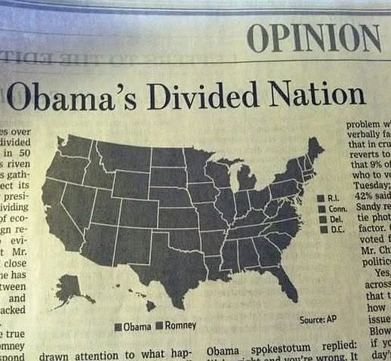


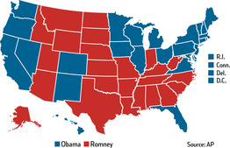
Example: Political Poll
Needs colors that are distinguishable in monochromatic.
This is the original color version.
Notes:
2012 U.S. presidential election; https://www.wsj.com/articles/SB10001424127887324439804578103470239517336

Slide 21
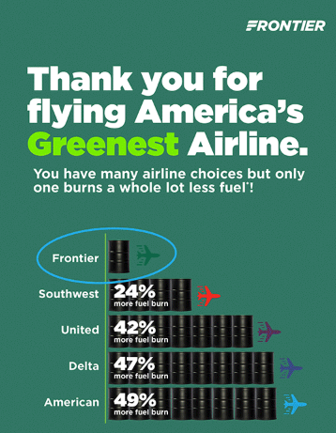
Example: Airline advertisement
Update the x-axis to include 0.
Remove the different colored airplane icons.
If using barrels to indicate units, they need to be equally spaced for each group, thus necessitating partial barrels.
Compares Frontier’s average, a smaller regional airline, to averages of other airlines, some are intercontinental. Should be only comparing to similar aircraft capacities or routes.

Slide 22
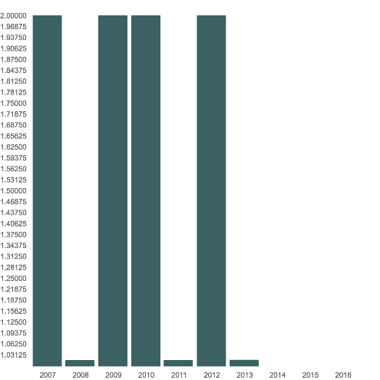
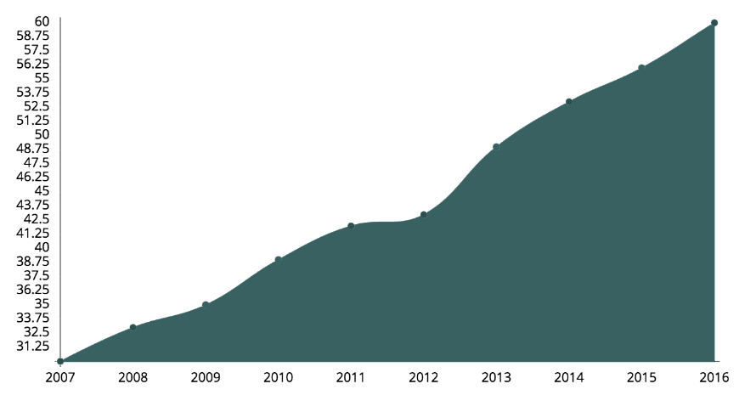

Example: Endangered species monitoring
Estimated amur leopard population
between 2007 and 2016
Estimated amur leopard deaths due to poaching between 2007 and 2016
Update the y-axes to include 0.
y-axes tick marks should be at whole numbers.
Remove shading from the scatterplot.
Consider converting the poaching information to a table.
Notes:
http://www.projectarkfoundation.com/animal/amur_leopard

Slide 23
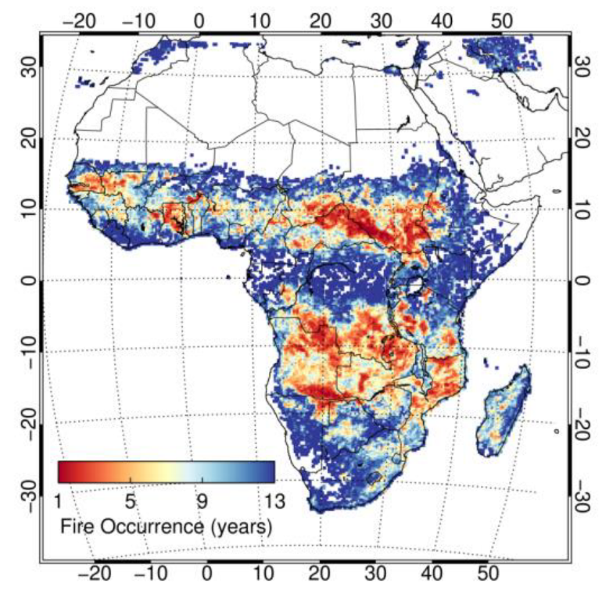
Example: Wildfire occurrences
Use of diverging color palette is incorrect. Should utilize a sequential palette.
Legend label is confusing. Perhaps “Years between wildfires” is more informative.
Remove latitude and longitude labels and gridlines.
Misleading display of truncated data.
Notes:
https://www.mdpi.com/2072-4292/10/10/1591

Slide 24
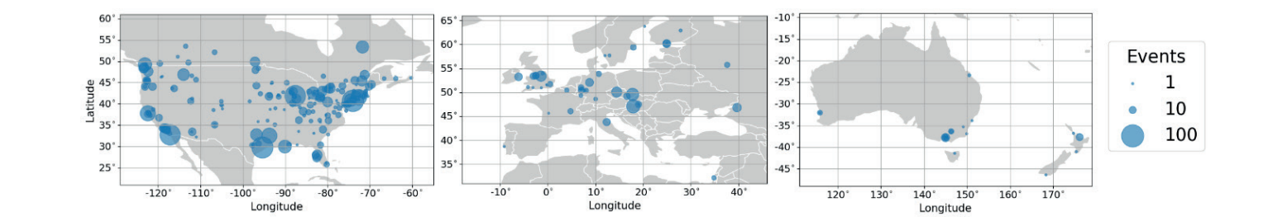

Example: Beer mile races
Vertical scales across the row are different ranges. (confusing)
Eliminate chart junk:
  Black country outlines with white or lighter gray land color.
  Remove latitude and longitude gridlines and axis labels.
Could add short titles or label the land areas shown.
  Consider map projection/stretching when graphing.
Reconsider the purpose of this display, given the article’s premise and goals.
Notes:
L. Menicali et al, Chug, run, repeat: A statistical analysis of beer-mile performance, Significance, Volume 23, Issue 4, July 2026, Pages 8–13, https://doi.org/10.1093/jrssig/qmag041

Slide 25
Real Data Exploration Examples
Using real data, discuss how to update default R ggplot2 graphics to follow the three laws and be accessible.
Example code, data:
https://meganheyman.github.io/

Slide 26
Do not edit
How to change the design
Which data exploration application are you most interested in?
The Slido app must be installed on every computer you’re presenting from

Slide 27
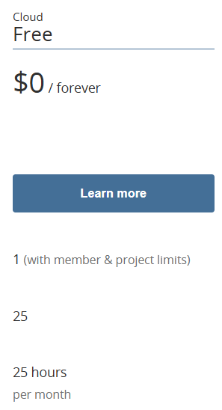
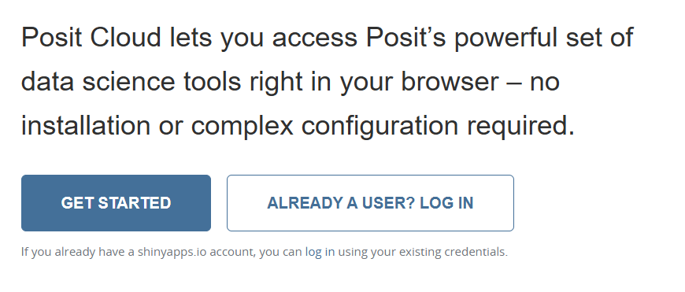
Accessing the free Posit Cloud
Navigate to https://posit.cloud/
Sign Up:
Provide an email, password, and name.
Then, verify email.

Slide 28
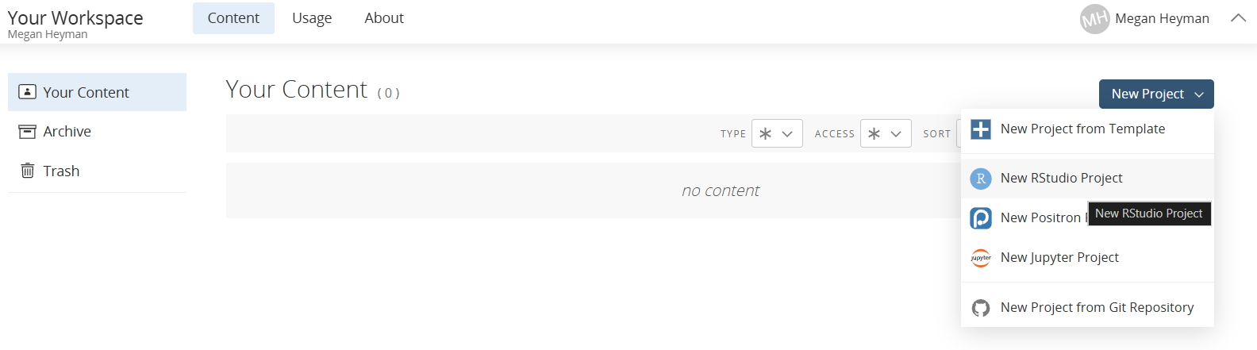
Computing in the free Posit Cloud
Once you’ve logged in and can see your workspace,

Slide 29
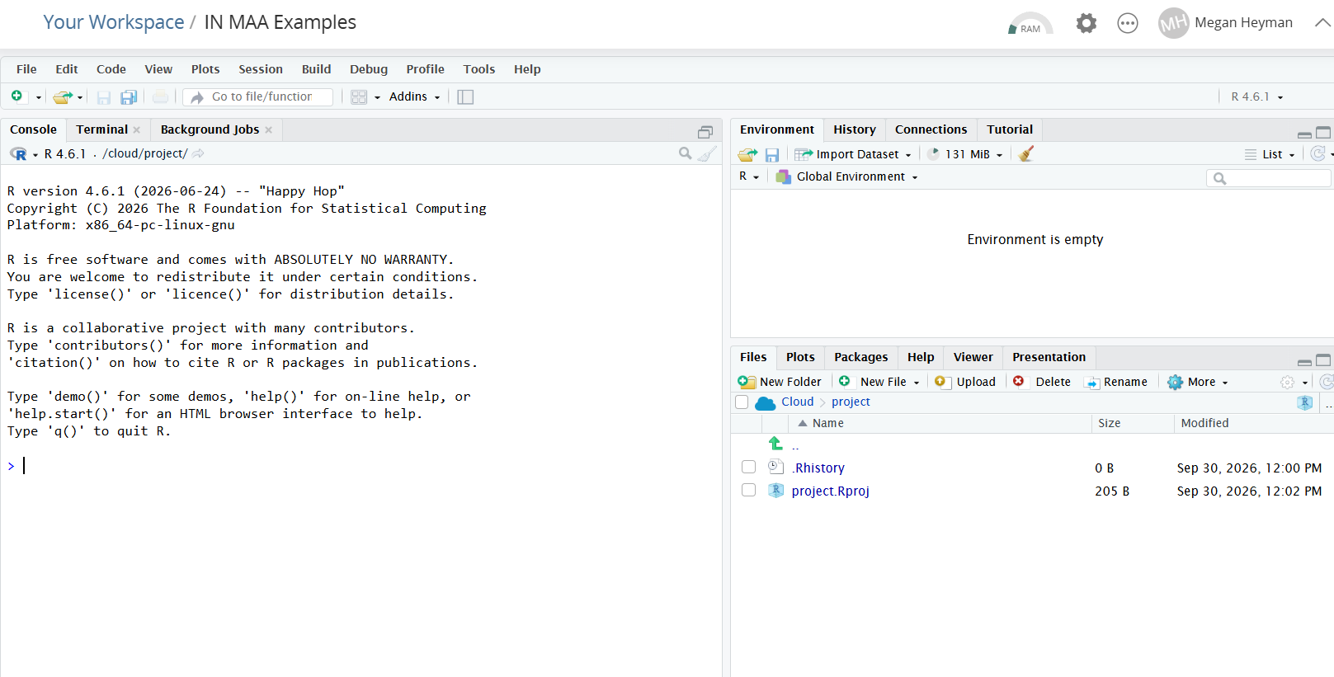
Computing in the free Posit Cloud

Slide 30
Go to data exploration
Taylor Swift album tracks on Spotify
Microplastics in oceans

Slide 31

Taylor Swift album tracks dataset
Taylor Swift is an American singer-songwriter. She started her career in country music as a teenager before changing to pop music. On Spotify, a music streaming app, she is the most streamed artist of all time with more than 129 billion streams.
The data come from the taylor R package.
We will examine danceability of 246 Taylor Swift album tracks found among twelve of her studio albums.
Danceability is a metric created by Spotify that measures how suitable a track is for dancing. It is scored on a scale from 0 (least danceable) to 1 (most danceable)

Slide 32
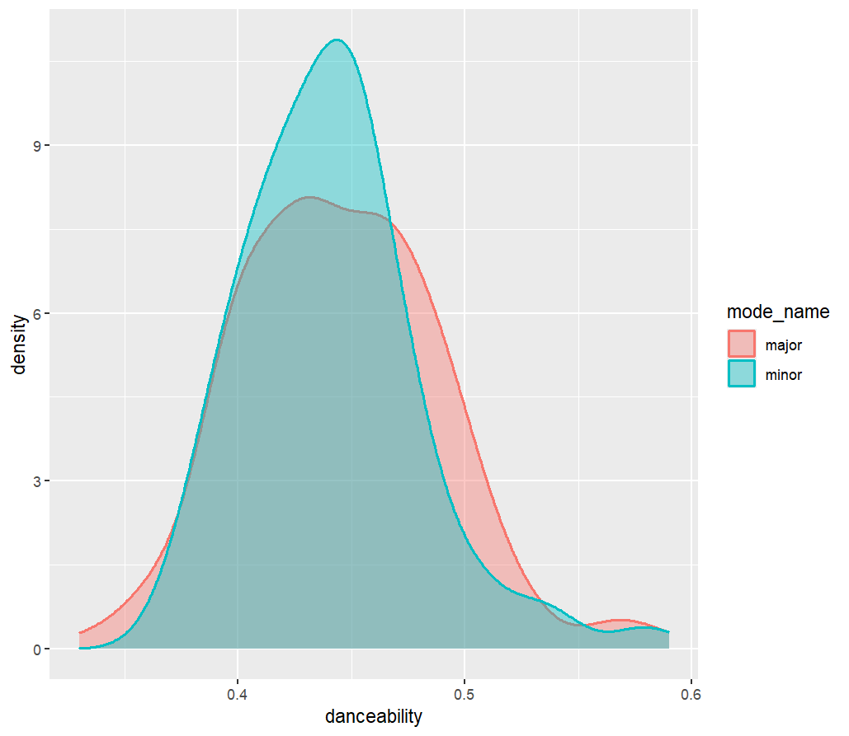

How does danceability of Taylor Swift tracks differ between songs in major and minor keys?
R code:
ggplot(TSData,
aes(x=danceability, fill = mode_name,
color=mode_name)) +
geom_density(alpha = 0.4, linewidth = 0.8)
x-axis range
chart junk
legend title

Slide 33
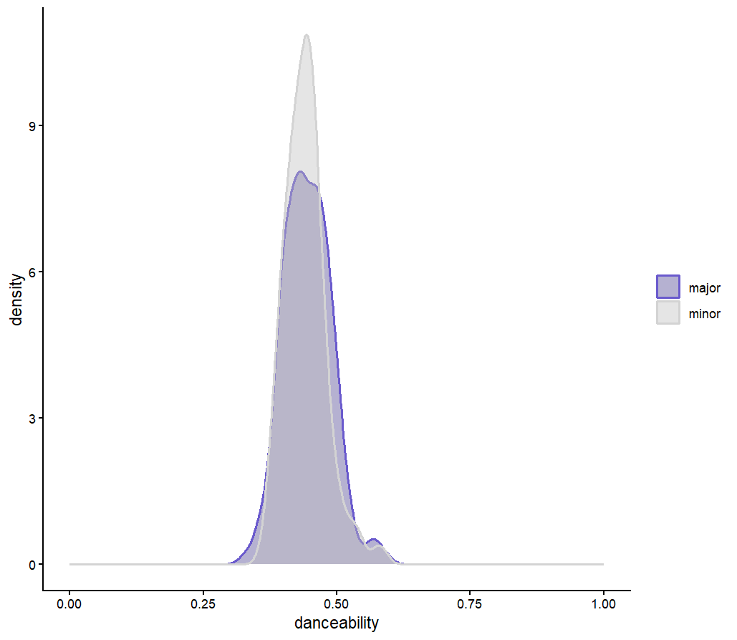

Taylor Swift tracks: Overlaid density plots
R code:
ggplot(TSData,
aes(x=danceability,
fill=mode_name,
color=mode_name)) +
geom_density(alpha=0.4, linewidth=0.8) +
scale_fill_manual(values=c(
"major" = "slateblue4",
"minor" = "gray")) +
scale_color_manual(values=c(
"major" = "slateblue",
"minor" = "lightgray")) +
xlim(c(0, 1)) + theme_classic() +
theme(legend.title=element_blank())

Slide 34
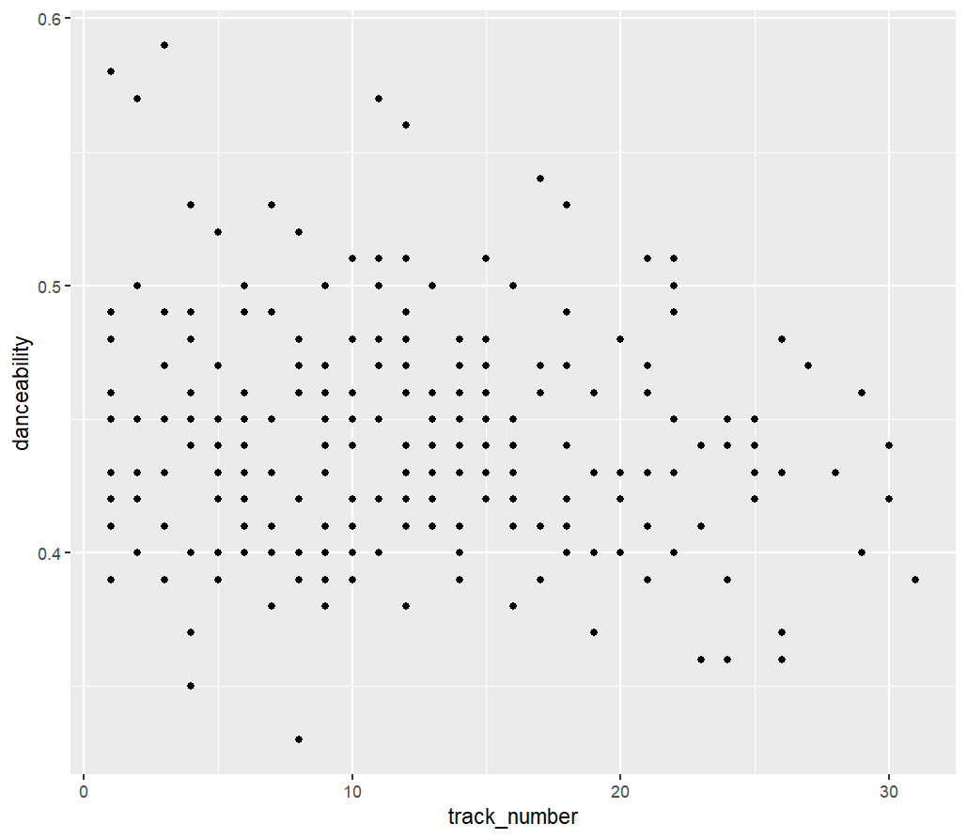

Is there evidence of a linear relationship between danceability and order within Taylor Swift track?
R code:
ggplot(TSData,
aes(y = danceability,
x = track_number)) +
geom_point()
overplotting
x-axis range/tick marks
chart junk
missing linear visualization

Slide 35
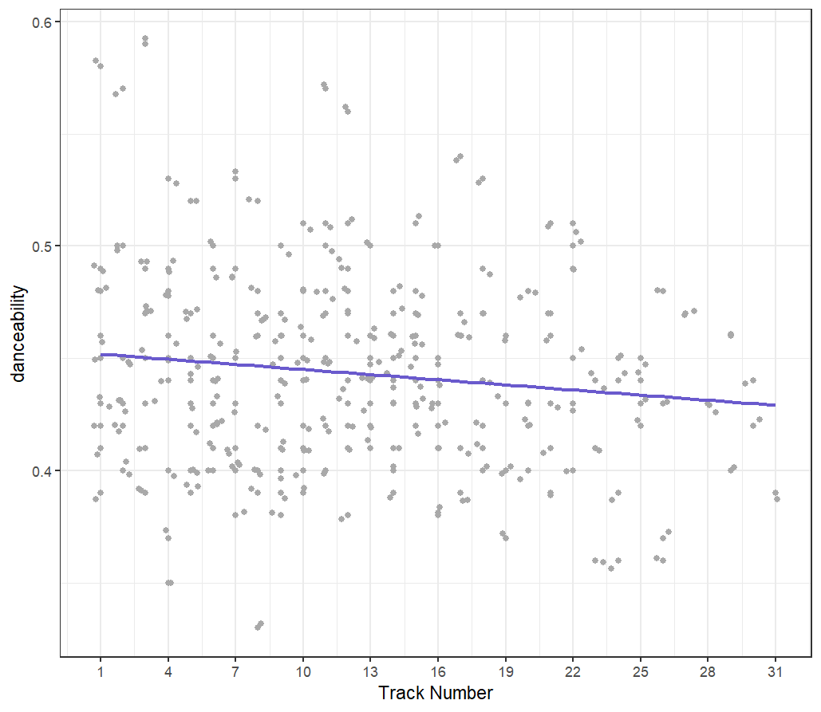

Taylor Swift tracks: Scatterplot
R code:
ggplot(TSData, aes(y = danceability,
x = track_number)) +
geom_point(color = "darkgray") +
geom_jitter(color = "darkgray") +
labs(x = "Track Number") +
scale_x_continuous(breaks=seq(1,31, by=3))+
geom_smooth(method = "lm", se = FALSE,
color="slateblue") +
theme_bw()

Slide 36
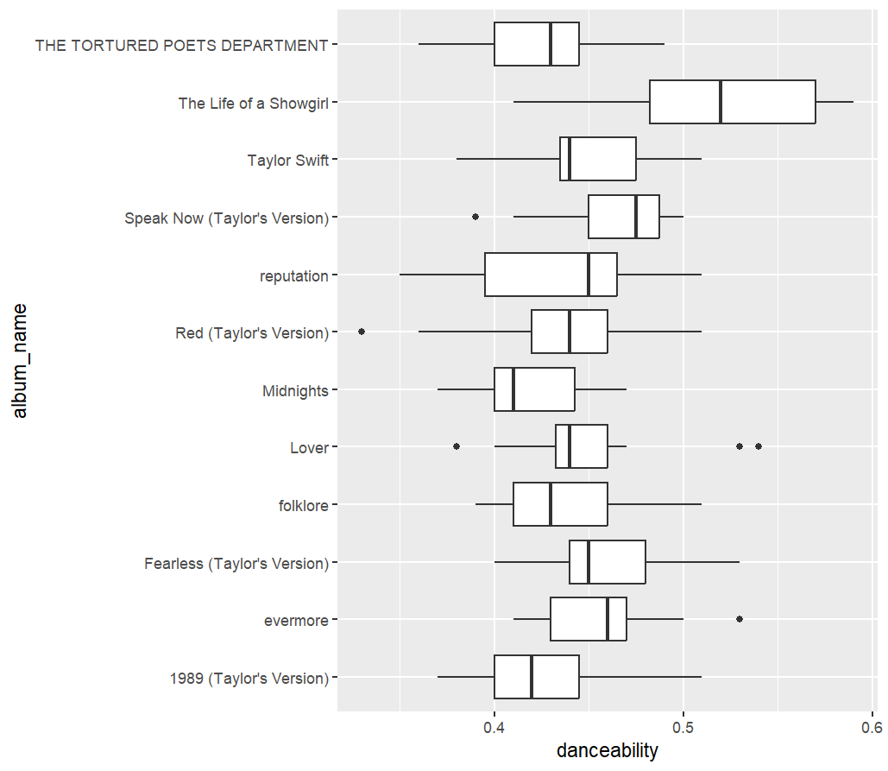
How does danceability of Taylor Swift tracks differ among her studio albums?
R Code:
ggplot(TSData,
aes(x=danceability, y=album_name)) +
geom_boxplot()
x-axis range
y-axis order
chart junk
summarized, not raw data

Slide 37
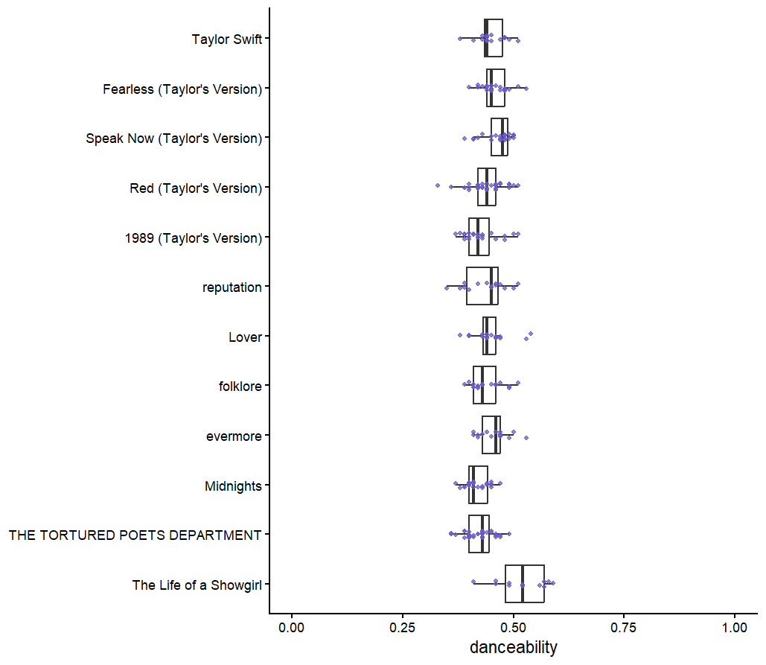
Taylor Swift tracks: side-by-side boxplots
R code (set factor level order):
album_order <- rev(c("Taylor Swift",
"Fearless (Taylor's Version)",
"Speak Now (Taylor's Version)",
"Red (Taylor's Version)",
"1989 (Taylor's Version)",
"reputation", "Lover",
"folklore", "evermore",
"Midnights",
"THE TORTURED POETS DEPARTMENT",
"The Life of a Showgirl"))
TSData$album_name <-factor(TSData$album_name,
levels=album_order)
R code (graph):
ggplot(TSData,
aes(x=danceability, y=album_name)) +
geom_boxplot(outlier.shape = NA) +
geom_point(color = "slateblue",
position = position_jitterdodge(jitter.width = 0.2,
dodge.width = 0.8),
size = 1, alpha = 0.75) +
xlim(c(0, 1)) +
theme_classic() +
theme(axis.title.y = element_blank())

Slide 38
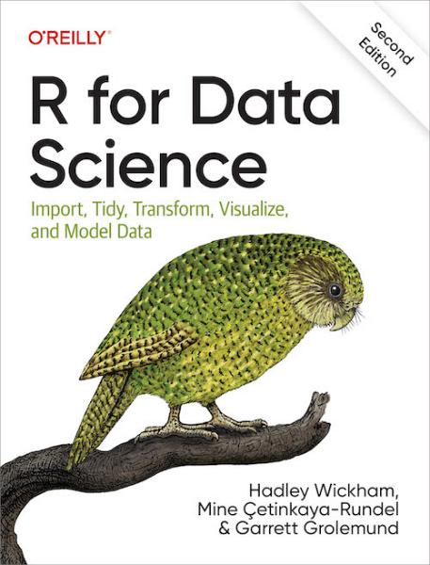
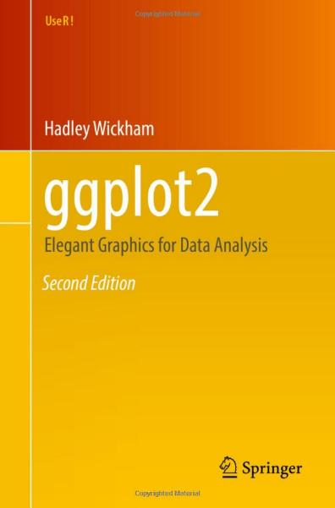
Some references for ggplot2
R for Data Science (2e)
Gentle/quick introduction
Section on visualization
ggplot2: Elegant Graphics for Data Analysis (3e)
Technical/in-depth

Slide 39
Putting It All Together

Slide 40
Summary
Use the three laws of effective visual communication to help build informative graphs. Use these to identify bad, misleading graphs.
  Have a clear purpose
  Show the data clearly
  Make the message obvious
Consider accessibility of the graphic to be inclusive of all audience types.
We used the three laws to help identify misleading and uninformative aspects of some published charts.
We used the three laws to improve default graphs generated from a real dataset.

Slide 41
Thank you!
These slides and other relevant resources that we discussed are available at: https://meganheyman.github.io/
Contact: Megan Heyman (heyman@rose-hulman.edu)
Thank you to Justin Lambright for organizing/moderating this session and to the Indiana Section of MAA for allowing me to present today.

Slide 42
Appendix:
Guidelines for Creating Tables
Sometimes it is better to display the information using a table.

Slide 43
Elements of tables
Layout
It is easier to compare numbers vertically than horizontally.
Digits
Keep the number of digits consistent within a row or column.
Avoid unnecessary precision; fewer digits facilitates reading.
Alignment
Numbers are right-aligned.
Multiple numbers in table cells
Consider splitting into multiple table cells, rows, or columns.
Emphasize the important number of multiple must be in the same cell.
Notes:
“Presenting data the Significance way: Part 2” Significance, September 2024, p.36

Slide 44
Elements of tables (continued)
Orientation
Landscape orientation is discouraged.
Do not want to necessitate rotating the document for reading unless completely necessary.
Could split into two tables; comparisons are more difficult.
Fonts and colors
Only utilize different fonts or colors to highlight a particular value.
Remember accessibility.
Notes:
“Presenting data the Significance way: Part 2” Significance, September 2024, p.36

Slide 45
Appendix:
Microplastics data exploration option

Slide 46
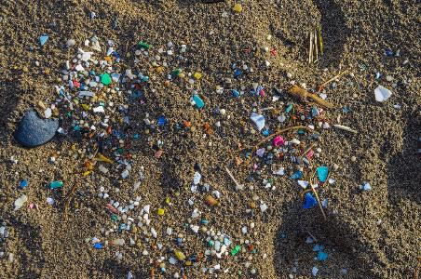
Ocean microplastics dataset
Plastic is the most prevalent type of marine debris found in oceans. Plastic that is less than five millimeters in length is called microplastic. Little is known about the impacts of microplastics yet.
Our data came from the NOAA Marine Microplastics Web Map tool.
This short exploration will examine cases from the most recent 25 years (2000 – 2024).
Only kept cases with the same units of measure (microplastics pieces / m³) and obtained via manta net or Neuston net.
  9,995 observations from professional and citizen science studies
Notes:
https://oceanservice.noaa.gov/facts/microplastics.html (defmition of microplastics);

Slide 47
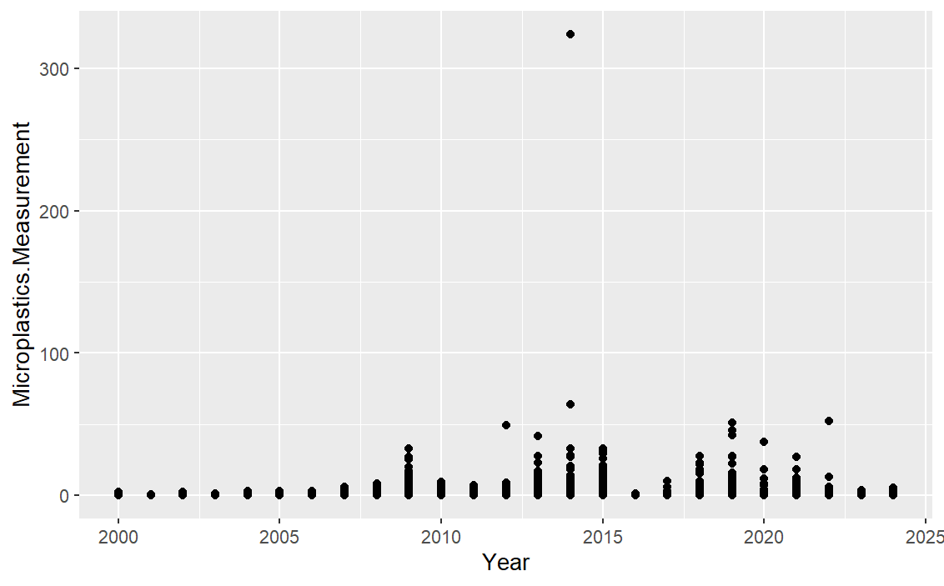
How has the presence of microplastics in oceans changed over the most recent 25 years?
Chart junk: gray shading in background
y- axis & title need to be updated
Jitter
Point size, transparency
Vertical axis format
Missing visual of trend
R code:
ggplot(data = Microplastics,
mapping = aes(x = Year,
y = Microplastics.Measurement)) +
geom_point()

Slide 48
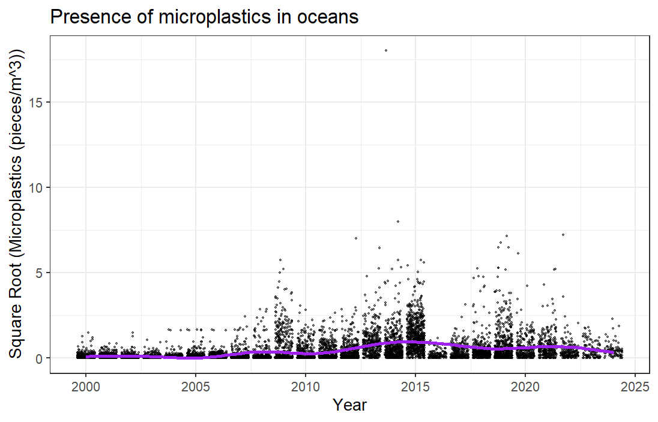
How has the presence of microplastics in oceans changed over the most recent 25 years?
R code:
Microplastics <- mutate(Microplastics,
sqrtMeas = sqrt(Microplastics.Measurement))
ggplot(data = Microplastics,
mapping = aes(x = Year, y = sqrtMeas)) +
geom_jitter(size = 0.5, alpha = 0.5) +
labs(y = "Square Root (Microplastics (pieces/m^3))",
title = "Presence of microplastics in oceans") +
geom_smooth(se = FALSE,
color="purple") +
theme_bw()

Slide 49
How has the presence of microplastics in oceans changed over the most recent 25 years?
Often, think of a scatterplot with points connected by lines.
We need to summarize the measurements for each year
Sample mean: average all measurements of microplastics in a given year
Sample median: 50th percentile, or middle value, of the measurements of microplastics in a given year
R code:
avgMicro <- Microplastics |>
group_by(Year) |>
summarize(avgMicroplastics = mean(Microplastics.Measurement),
medMicroplastics = median(Microplastics.Measurement))

Slide 50
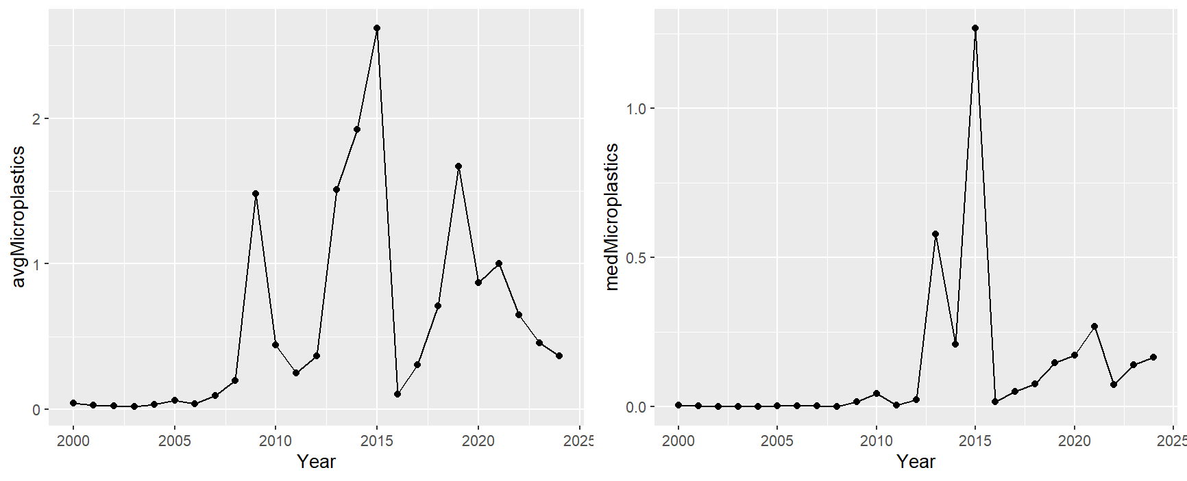
How has the presence of microplastics in oceans changed over the most recent 25 years?
R code:
p1 <- ggplot(data = avgMicro,
mapping = aes(x = Year, y = avgMicroplastics)) +
geom_line() +
geom_point()
p2 <- ggplot(data = avgMicro,
mapping = aes(x = Year, y = medMicroplastics)) +
geom_line() +
geom_point()
grid.arrange(p1, p2, ncol = 2)
Chart junk: gray shading in background
Labels need to be updated
Vertical axis limits

Slide 51
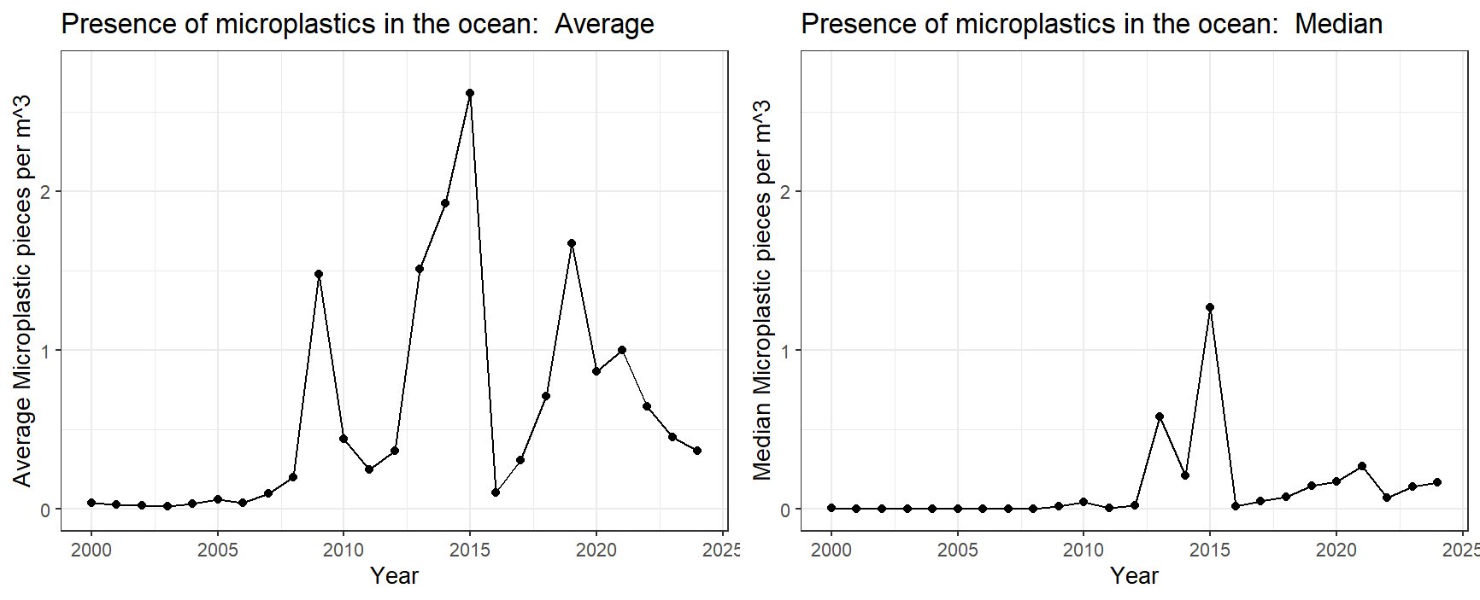
How has the presence of microplastics in oceans changed over the most recent 25 years?

Slide 52
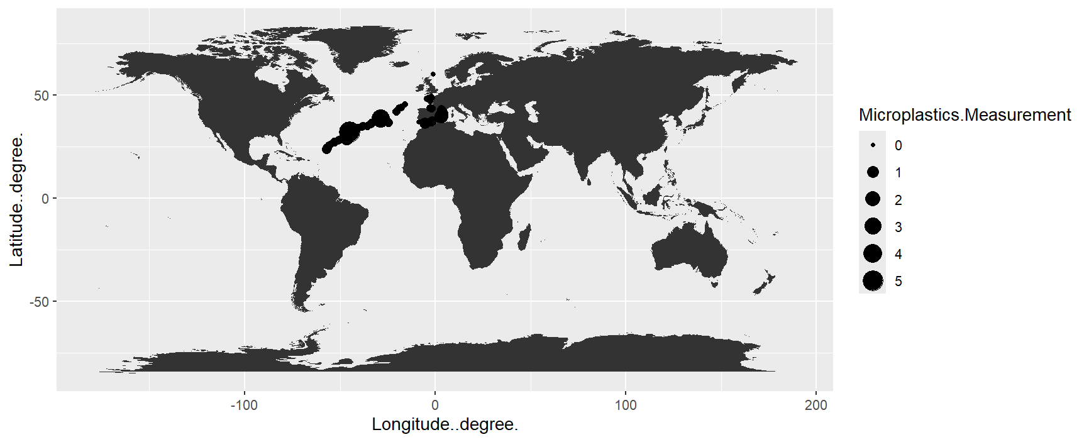
Most recently, where do microplastics have a higher presence when we just consider the Atlantic Ocean?
Subset the data R code:
Atlantic24 <- Microplastics |>
filter(Ocean == "Atlantic Ocean", Year == 2024)
R code:
globe <- map_data("world")
ggplot() +
geom_map(data = globe,
mapping = aes(map_id = region),
map = globe) +
geom_point(data = Atlantic24,
aes(x = Longitude..degree.,
y = Latitude..degree.,
size = Microplastics.Measurement)) +
expand_limits(x = globe$long, y = globe$lat)
Coloring of points, land, and ocean all need help
Axis scales not informative
Only interested in Atlantic ocean
Point transparency

Slide 53
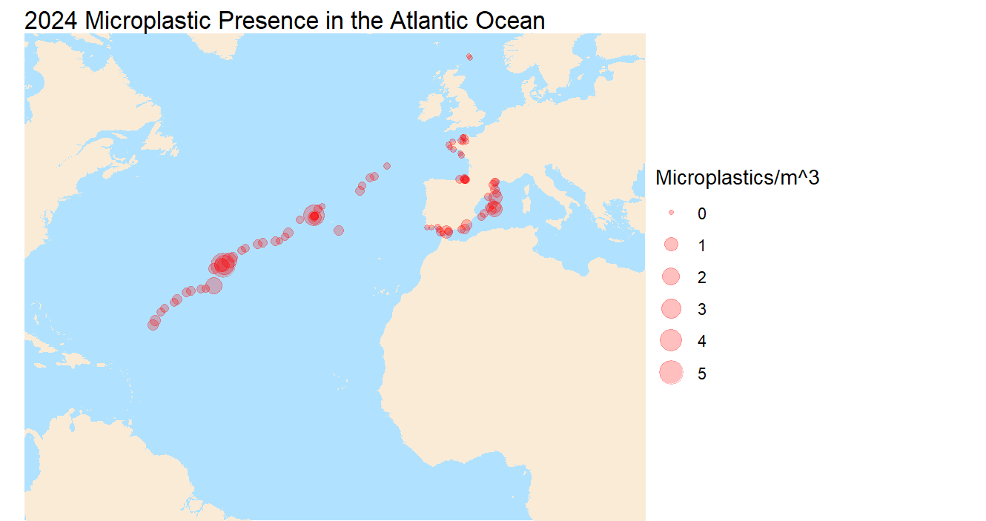
Most recently, where do microplastics have a higher presence when we just consider the Atlantic Ocean?
Go to graphing references

